Slide 1

Blockchain
Smart Contract with Solidity

Slide 2
Solidity
is a programming language specifically designed for developing smart contracts on blockchain platforms, primarily Ethereum. It is a statically-typed, contract-oriented language that allows developers to write code for decentralized applications (DApps), decentralized autonomous organizations (DAOs), and other blockchain-based projects.
Solidity is a statically typed language, which means that the state or local variable type needs to be specified during declaration. Each declared variable always have a default value based on its type. There is no concept of "undefined" or "null".
Each Smart Contract has its own address.

Slide 3
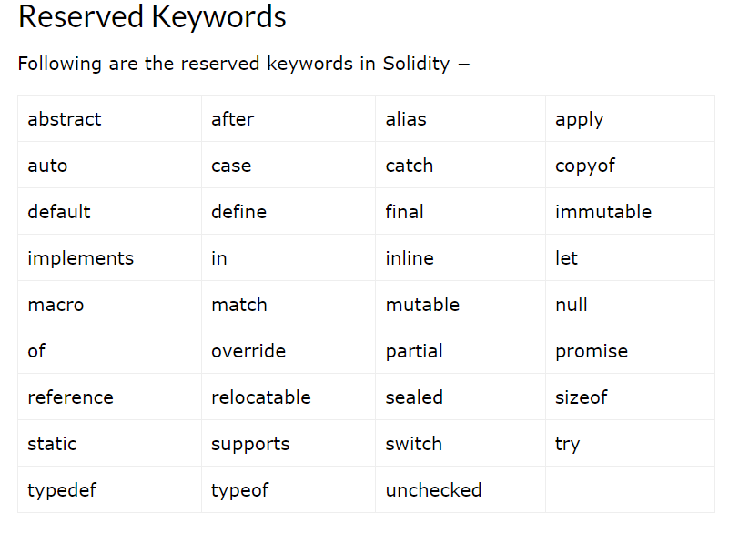
Solidity Keywords

Slide 4
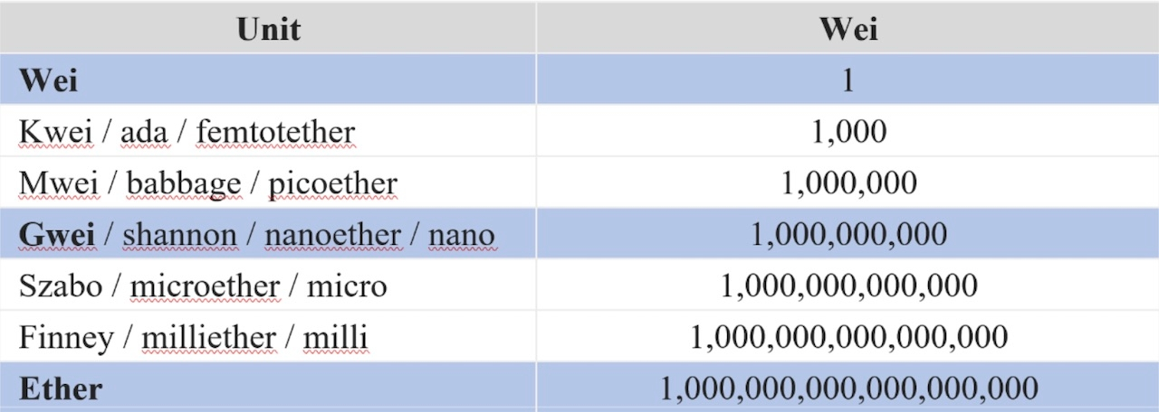
Gas and units
Every transaction which modify the state of the blockchain require gas fees paid for the minors , gas fees are changed depending on the state of the blockchain and the complexity of the called function.

Slide 5
Syntax
Firstly we define the License Of the smart Contract in the first line of code (Optional) 1. // SPDX-License-Identifier: MIT it must be the first line to execute when we use
We can use // for commenting a line and /* */ for multiple lines.
We must introduce the compiler version of the smart contract to let the compiler of solidity knows what the version is used. 1. pragma solidity 0.8.8; // a fixed compile Version 1. pragma solidity ^0.8.0; // that version or any later version pragma solidity >=0.8.0 <0.9.0; // any Version Between this Range

Slide 6
Importing Files
Though above example does not have an import statement, but Solidity supports import statements that are very similar to those available in JavaScript.
The following statement imports all global symbols from "filename".
import "filename";
The following example creates a new global symbol symbolName whose members are all the global symbols from "filename".
import * as symbolName from "filename";
To import a file x from the same directory as the current file, use import "./x" as x;. If you use import "x" as x; instead, a different file could be referenced in a global "include directory".

Slide 7
Print in console for debugging
1. import "hardhat/console.sol";
2. // in the contracts function, when we call a function it will print in console.
3. console.logBytes32(bytes32);
4. console.logBytes(bytes);
5. console.log(String/uint256);

Slide 8
Contract
you can think as if it is a class in other languages like java. But once it executed, we can’t stop or changing it’s functionality Unless we have prepared functions that update the state of the Smart contract.
A Solidity contract is a collection of code (its functions) and data (its state) that resides at a specific address on the Ethereum blockchain.
1. Contract contractName {
2. // our code ..
3.}

Slide 9
Data types
Boolean: Represents true or false values. It's declared using bool.
Could use the same logical and Comparisons operators as any language. bool isTrue = true; Integers: Solidity supports both signed and unsigned integers of different sizes, including int8, int16, int256, uint8, uint16, uint256, and more.
o Could use arithmetic operators and bitwise , shift operators as other languages. 1. int8 myInt = -42; // signed with the size of 8 bits
2. uint256 myUInt = 12345; // unsigned with the size of 256 bits (max)
3. int exponentiation = 0**0; // defined as 1
4. uint exp2 = 1e18; // is equal to 1 * 10**18
Fixed Point Numbers : Fixed point numbers are not fully supported by Solidity yet. They can be declared but cannot be assigned to or from.

Slide 10
Data types
Address: Represents Ethereum addresses. It can store the 20-byte address of an external
account or contract. It's declared using address. 1. address payable recipient = 0x1234567890123456789012345678901234567890;
2. // payable if u want to pay to the address , it’s optional. Bytes: For example:
bytes1, bytes2, ..., bytes32 bytes32 myBytes = 0x1234567890abcdef; // max size is 32 for bytes

Slide 11
Data types
Strings: Represents variable-length strings. It's declared using string string greeting = "Hello, World!"; // as an array of bytes Enum: Allows you to create custom enumerations with a finite set of values. 1. enum Status { Pending, Approved, Rejected }
2. Status myStatus = Status.Pending; // value of 0 for the first one.
Structs: Custom user-defined composite data types, which allow you to group variables of different types together. 1. struct Person {
2. string name;
3. uint256 age;
4. }
5. Person alice;
6. alice.name = "Alice";
7. alice.age = 30;
8. Person Abdo = Person(“Abdalrhman”,23);

Slide 12
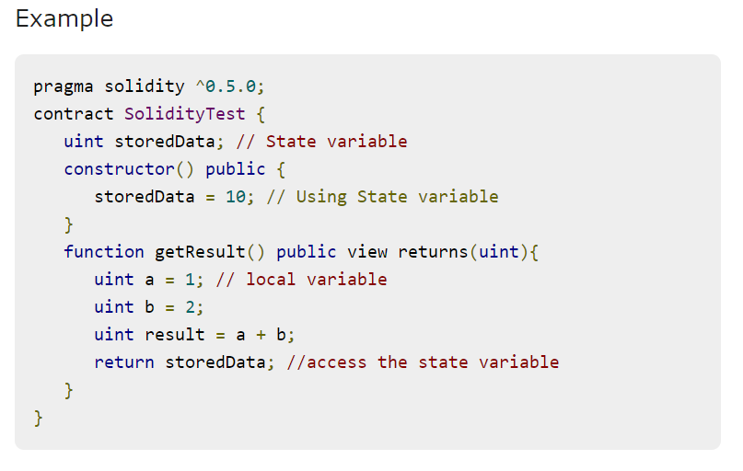
variables
State Variables − Variables whose values are permanently stored in a contract storage.
Local Variables − Variables whose values are present till function is executing.
Global Variables − Special variables exists in the global namespace used to get information about the blockchain.

Slide 13
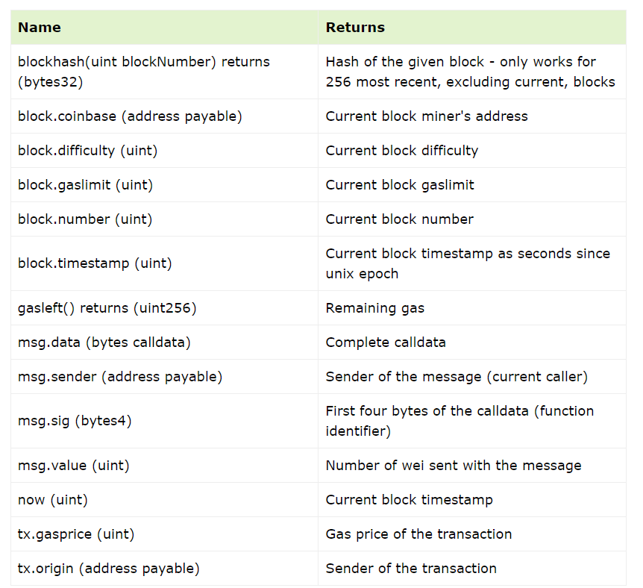
variables
These are special variables which exist in global workspace and provide information about the blockchain and transaction properties.

Slide 14
Solidity Variable Names
While naming your variables in Solidity, keep the following rules in mind.
You should not use any of the Solidity reserved keywords as a variable name. These keywords are mentioned in the next section. For example, break or boolean variable names are not valid.
Solidity variable names should not start with a numeral (0-9). They must begin with a letter or an underscore character. For example, 123test is an invalid variable name but _123test is a valid one.
Solidity variable names are case-sensitive. For example, Name and name are two different variables.

Slide 15
Variable Scope
Scope of local variables is limited to function in which they are defined but State variables can have three types of scopes.
Public − Public state variables can be accessed internally as well as via messages. For a public state variable, an automatic getter function is generated.
Internal − Internal state variables can be accessed only internally from the current contract or contract deriving from it without using this.
Private − Private state variables can be accessed only internally from the current contract they are defined not in the derived contract from it.
external

Slide 16
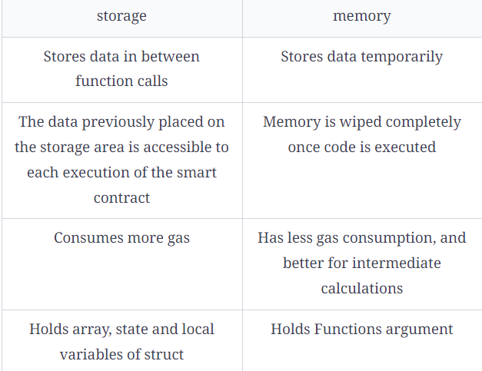
Storage Vs Memory
memory is a keyword used to store data for the execution of a contract. It holds functions argument data and is wiped after execution.
storage can be seen as the default solidity data storage. It holds data persistently and consumes more gas.
Use storage for data that needs to be permanently stored and shared among functions and external actors.
Use memory for temporary data needed during the execution of a function, which does not need to be stored on the blockchain. It is more gas-efficient and has a local scope.

Slide 17
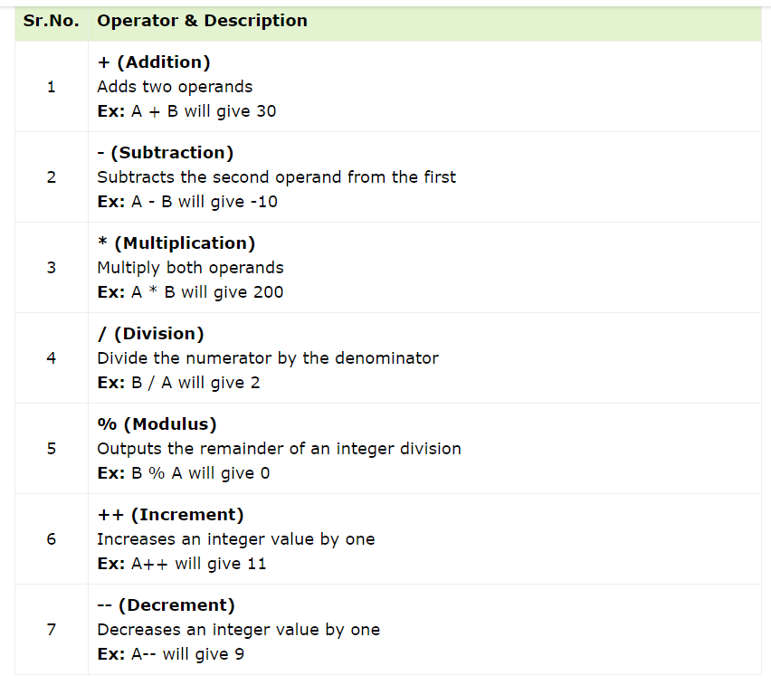
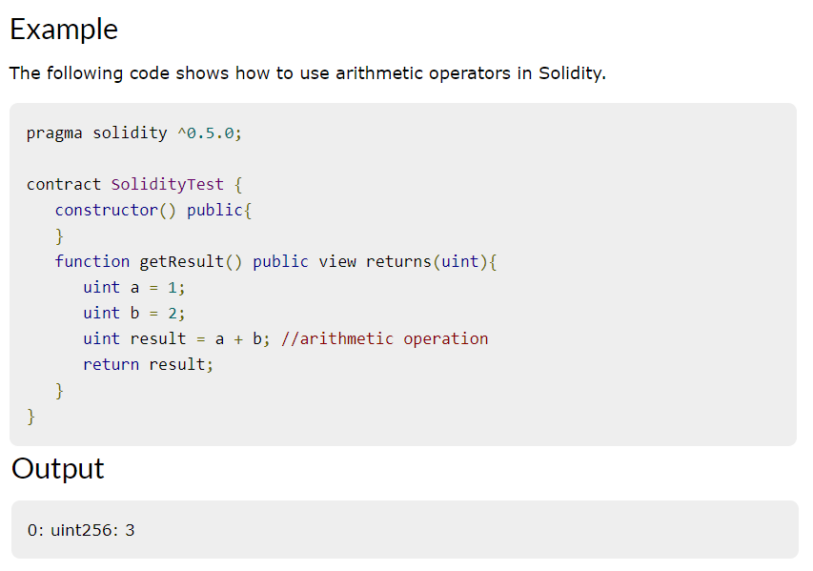
Operators
Arithmetic Operators
Solidity supports the following arithmetic operators
Assume variable A holds 10 and variable B holds 20, then

Slide 18
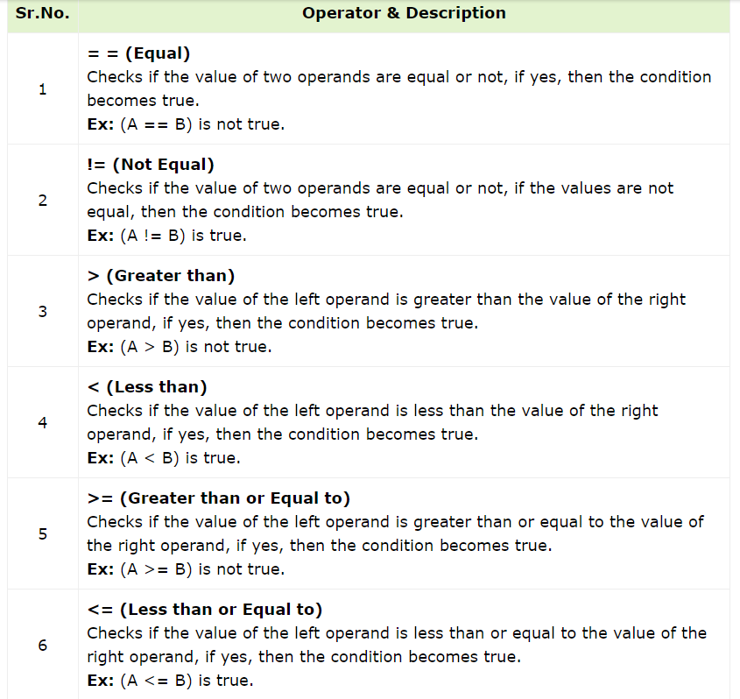
Operators
Comparison Operators

Slide 19
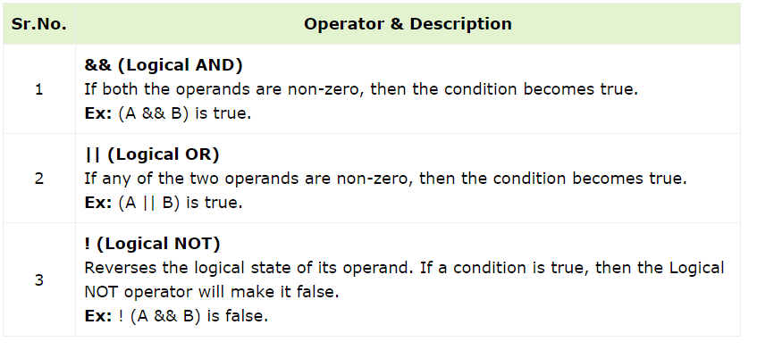
Operators
Logical (or Relational) Operators

Slide 20
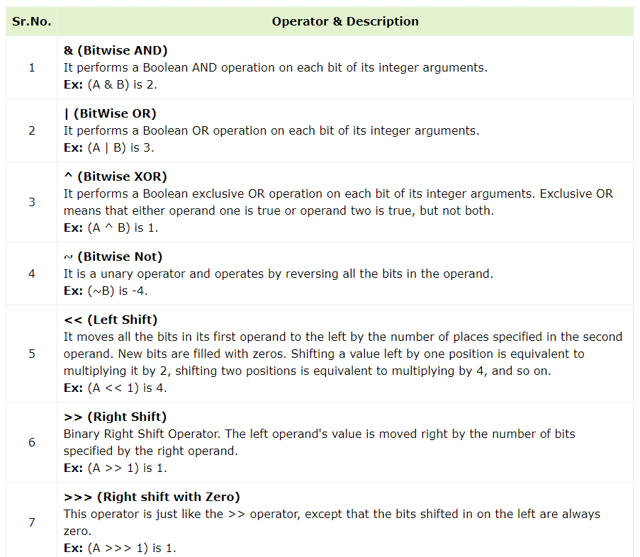
Operators
Bitwise Operators
Assume variable A holds 2 and variable B holds 3

Slide 21
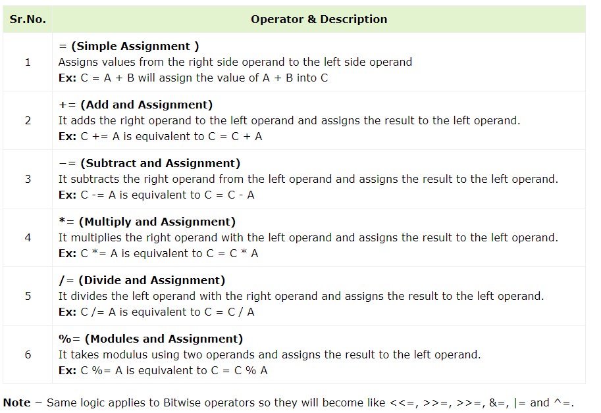
Operators
Assignment Operators

Slide 22
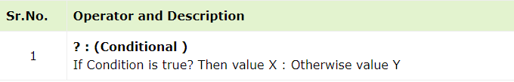
Operators
Conditional (or ternary) Operators (? :)
The conditional operator first evaluates an expression for a true or false value and then executes one of the two given statements depending upon the result of the evaluation.
function getResult() public view returns(unit){
uint a = 1; // local variable
uint b = 2;
uint result = (a > b? a: b); //conditional operation
return result;
}

Slide 23
Casting
Implicit Casting (Widening): This is a type of casting where a smaller data type is automatically converted to a larger data type without the need for explicit casting .
1. uint8 a = 42;
2. uint16 b = a; // Implicit casting from uint256 to int256 Explicit Casting (Narrowing): Explicit casting is required when you want to convert a larger data type to a smaller one. This may result in data loss or truncation if the value cannot be accurately represented in the smaller data type. 1. int256 x = 1000;
2. int8 y = int8(x); // Explicit casting from int256 to int8 (data may be truncated) Address Casting: You can cast between different address types in Solidity. For example, you can cast from address to address payable and vice versa. address payable recipient = address(someAddress); // Cast from address to address payable

Slide 24
Casting
Bytes to BytesN: You can cast from bytes to a fixed-size bytesN type, where N is the desired size. Be cautious when doing this as it may lead to data truncation. 1. bytes memory data = new bytes(10);
2. bytes4 dataAsBytes4 = bytes4(data); // Explicit casting to bytes4 Enum to Integer: You can cast from an enum to an integer and vice versa. Enum values are implicitly convertible to their underlying integer representation. 1. enum Status { Pending, Approved, Rejected }
2. Status currentStatus = Status.Approved;
3. uint8 statusValue = uint8(currentStatus); // Cast from enum to integer Integer to Enum: You can cast from an integer to an enum, but you need to be careful to ensure the integer corresponds to a valid enum value. 1. enum Status { Pending, Approved, Rejected }
2. uint8 statusValue = 1;
3. Status currentStatus = Status(statusValue); // Cast from integer to enum

Slide 25
Casting
Bytes to String (Not Recommended): Solidity doesn't provide a direct casting method to convert bytes to string. Converting between these types can be complex and is generally not recommended in most cases. It's better to use libraries or external functions to handle such conversions.
Bytes can be converted to String using string() constructor.
Ex:
bytes memory bstr = new bytes(10);
string message = string(bstr);
Ex2 for using library of convert int to a string:
1. import "@openzeppelin/contracts/utils/Strings.sol";
2.
3. Strings.toString(uint256)// to convert an int to a string.
4. string.concat(a, b); // where a , b are strings

Slide 26
Arrays
Solidity supports both fixed-size and dynamic arrays for all data types, including
user-defined types (struct). 1. uint256[] dynamicArray;
2. dynamicArray.push(7); // Add an element to the dynamic array
3. dynamicArray.pop(); // Remove the last element from the dynamic array
4. uint256 length = dynamicArray.length; // Get the length of the dynamic array
5. uint256 x = dynamicArray[length - 1]; // store last element of array in a variable
6. Person[5] fixedArray; // define a fixed struct array
7. fixedArray[index] = _value; // Set the value at a specific index
8. uint256[3] fixedArray = [10, 20, 30]; // Initialize a fixed-size array with values

Slide 27
Mappings
A Key-value data structures that are like hash maps or dictionaries in other languages.
characteristics:
Efficient Look-Up: Mappings are very efficient for looking up and retrieving values associated with a specific key (address in the example). The look-up operation is constant time (O(1)).
No Iteration: Unlike arrays and structs, mappings do not support iteration. You cannot loop through all the keys or values in a mapping directly.
Undefined Default Value: If you try to access a key that has not been set in the mapping, it returns the default value for the value type. In the example, if an address is not in the balances mapping, accessing it will return 0.
State Variables: Mappings are often used to manage state variables within smart contracts, allowing you to track various data for different addresses or entities.
Cannot be Returned: You cannot return the entire mapping from a function. If you need to access the mapping from external code, you typically provide individual access functions to return key’s value by another.
Mapping can only have type of storage and are generally used for state variables.
Mapping can be marked public. Solidity automatically create getter for it.

Slide 28
Mappings
Syntax:
mapping(_KeyType => _ValueType) map_name;
_KeyType : can be any built-in types plus bytes and string. No reference type or complex objects are allowed.
_ValueType : can be any type.
Ex:
1. mapping(_address => uint256) balances;
2. balances[msg.sender] = 1; // assign a value to map by accessing it with the key
3. uint256 balance = balances[_address]; // store the value of map key in variable

Slide 29
Immutable and constant
Immutable State Variables:
immutable is a state variable keyword introduced in Solidity 0.6.0. It is used to declare a state variable whose value can be set only once, and it is fixed thereafter. It's a more efficient and safer alternative to declaring constant values because it is computed and stored during contract deployment.
immutable variables are suitable for values that are known and determined at deployment and don't change during the contract's lifetime. They can be used to save gas costs compared to constant variables, which are recalculated at each access.
Immutable state variables can be of elementary types (e.g., uint, address, string) or reference types like structs.
1. pragma solidity ^0.8.0;
2.
3. contract MyContract {
4. immutable uint256 public fixedValue = 42;
5.
6. // ...
7. }

Slide 30
Immutable and constant
Constants are used in Solidity when it is clear that a variable will never change. When a state variable is defined as constant its value is assigned at compile time and no modification can be made at runtime. It is further not possible to assign data from the blockchain like block or transaction properties to a constant. These values should be declared as immutable variables.
The contract will save gas when a function is called that uses the constant.
// SPDX-License-Identifier: MIT
pragma solidity ^0.8.7;
contract Constants {
address public constant MY_ADDR = 0x0000000000000000000000000000000000000000;
string public constant MY_STRING = 'hello';
uint public constant MY_INT = 123;
bool public constant MY_BOOL = true;
}

Slide 31
Immutable and constant
What is the disadvantage of Constants compared to variables?
The main disadvantage of using constants is that we cannot use any blockchain data.
What is the difference between constants and immutable variables?
The main difference is that constants are defined at compile-time, while immutable variables are defined at deployment time. It is possible to assign blockchain data to immutable variables but not to constants.

Slide 32
Immutable and constant
Constant Functions (View and Pure):
Constant functions are functions that promise not to modify the state of the contract. There are two types of constant functions: view and pure.
view functions are read-only and do not modify the state. They can read state variables and are free to call other view functions.
pure functions are even more restrictive and do not access state variables. They are used for mathematical calculations and do not consume gas when called externally.
Constant functions are used for querying the state of the contract, and they are often called by external actors or other contracts.

Slide 33
Constant Functions (View and Pure):
1. pragma solidity ^0.8.0;
2. contract MyContract {
3. uint256 public stateValue = 100;
4.
5. function getValue() public view returns (uint256) {
6. return stateValue; // This function is 'view'
7. }
8.
9. function multiply(uint256 a, uint256 b) public pure returns (uint256) {
10. return a * b; // This function is 'pure'
11. }
12. }

Slide 34
Events
Events allow logging to the Ethereum blockchain. Some use cases for events are:
Listening for events and updating user interface
A cheap form of storage
Example:
contract Event {
// Event declaration
// Up to 3 parameters can be indexed.
// Indexed parameters helps you filter the logs by the indexed parameter
event Log(address indexed sender, string message);
event AnotherLog();
function test() public {
emit Log(msg.sender, "Hello World!");
emit Log(msg.sender, "Hello EVM!");
emit AnotherLog();
}
}

Slide 35
Events
types of parameters of events:
o Indexed Parameters:
You can declare up to three parameters as indexed in an event. These parameters allow for more efficient filtering when querying the event logs.
In the example above, user is declared as indexed. This allows clients to efficiently filter events based on the user parameter when searching through the blockchain's event logs.
o Non-Indexed Parameters:
Parameters that are not explicitly declared as indexed are nonindexed parameters.
Non-indexed parameters provide additional data about the event but do not offer the same level of efficient filtering when querying event logs

Slide 36
Decision Making (Conditions)
The if statement is the fundamental control statement that allows Solidity to make decisions and execute statements conditionally.
Syntax:
if (expression) {
Statement(s) to be executed if expression is true
} else if (expression 2) {
Statement(s) to be executed if expression 2 is true
} else {
Statement(s) to be executed when above expressions are false
}

Slide 37
Revert Vs require Vs assert
revert and require are two mechanisms used for error handling and control flow within smart contracts. They are used to check conditions and revert the execution of a transaction or function if those conditions are not met. Both mechanisms prevent further execution and revert any state changes that occurred before the error condition was encountered.
Require:
require is used to check a condition and revert the transaction if the condition evaluates to false. It is used to validate inputs and conditions within a function.
Unlike revert, require does not consume all the gas; it refunds any remaining gas to the sender. It is often used for input validation.
You can provide an optional error message to explain why the condition was not met. Example:
function someFunction(uint256 value) public {
2. require(value > 0, "Value must be greater than 0");
3. // Continue execution if the condition is met; refund unused gas
4. // Perform other operations
5.}

Slide 38
Revert Vs require Vs assert
Revert:
revert is used to revert the entire transaction, including any state changes and gas consumption, back to the previous state.
It is typically used when a critical error condition is encountered, and you want to stop the execution of the transaction and revert all changes.
You can provide an optional error message to explain the reason for the revert.
6. function anotherFunction() public {
7. if (someCondition) {
8. revert("Critical error: Something went wrong"); // could declare an Error to be reverted to safe gas. And that will be better than pass a string to be reverted.
9. }
10. // Continue execution if no revert occurred
11. }

Slide 39
Revert Vs require Vs assert
Define a Custom Error: it saves more gas than storing message and pass it with revert.
Example:
1. error ValueMustBeGreaterThanZero(string message);// before define a contract , could have
2. no parameters
1. function checkValue(uint256 value) public pure {
2. if (value <= 0) {
3. revert ValueMustBeGreaterThanZero("Value must be greater than zero");
4. }
5. // Continue execution if the condition is met
6. }
Different between revert and require.
revert consumes all the gas and reverts all state changes and operations, making it suitable for critical errors.
require refunds any unused gas and is often used for input validation and noncritical conditions.

Slide 40
Revert Vs require Vs assert
Assert:
Use assert for internal consistency checks within your contract. assert should not be used for input validation.
It consumes all the gas, even if the condition is true, and is primarily used for checks that should never fail.
When an error occurs, the transaction is reverted, and any changes to the contract’s state are undone. The user who initiated the transaction will receive an error message if a custom error message was provided.
Example:
1. function someInternalFunction(uint256 value) internal {
2. assert(value > 0);
3. // Continue execution if the condition is true
4. }

Slide 41
Try Catch
Try and catch are used for error handling.
Example:
try token.transfer(someAddress, 123) returns (bool transferSuccessful) {
...
}
catch internal (bytes memory returndata) {
revert(returndata);
}
catch {
revert;
}
Notes:
https://solidity-by-example.org/try-catch/
https://forum.soliditylang.org/t/call-for-feedback-the-future-of-try-catch-in-solidity/1497

Slide 42
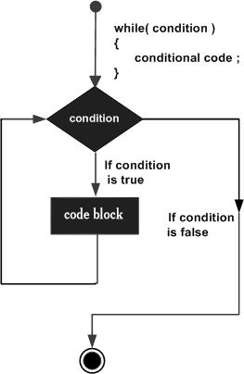
Loops
The most basic loop in Solidity is the while loop which would be discussed in this chapter. The purpose of a while loop is to execute a statement or code block repeatedly as long as an expression is true. Once the expression becomes false, the loop terminates.
Syntax: while (expression) {
Statement(s) to be executed if expression is true
}

Slide 43
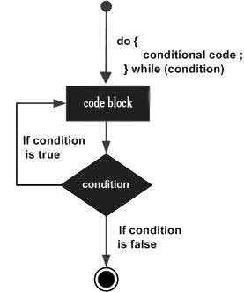
Loops
The do...while loop is similar to the while loop except that the condition check happens at the end of the loop. This means that the loop will always be executed at least once, even if the condition is false.
Syntax: do {
Statement(s) to be executed;
} while (expression);
Note − Don't miss the semicolon used at the end of the do...while loop.

Slide 44
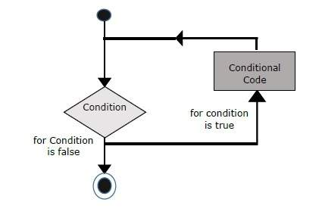
Loops
The for loop is the most compact form of looping. It includes the following three important parts :
The loop initialization where we initialize our counter to a starting value. The initialization statement is executed before the loop begins.
The test statement which will test if a given condition is true or not. If the condition is true, then the code given inside the loop will be executed, otherwise the control will come out of the loop.
The iteration statement where you can increase or decrease your counter.
Syntax:
for (initialization; test condition; iteration statement) {
Statement(s) to be executed if test condition is true
}

Slide 45
Loop Control
Solidity provides full control to handle loops and switch statements. There may be a situation when you need to come out of a loop without reaching its bottom. There may also be a situation when you want to skip a part of your code block and start the next iteration of the loop.
To handle all such situations, Solidity provides break and continue statements. These statements are used to immediately come out of any loop or to start the next iteration of any loop respectively.

Slide 46
Functions
Before we use a function, we need to define it. The most common way to define a function in Solidity is by using the function keyword, followed by a unique function name, a list of parameters (that might be empty), and a statement block surrounded by curly braces.
Syntax:
function function-name(parameter-list) scope optkeyword returns(return_list) {
//statements..
}
scope (Visibility Specifiers) are one of those:
1. public → visible for all
2. private → visible only for current contact
3. internal → visible only internally (between contracts) (default)
4. external → visible only for functions and open for any

Slide 47
Functions
Optkeyword like view and pure (read only function):
View Functions (formerly Constant Functions): View functions promise not to modify the state of the contract. They are used for querying the state and do not consume gas when called externally. They can be called by external and internal actors. Its like Getters.
function myFunction() public view returns (uint256) {
return x;
} // x is a state variable
Uses:
Modifying state variables.
Emitting events.
Creating other contracts.
Using selfdestruct.
Sending Ether via calls.
Calling any function which is not marked view or pure.
Using low-level calls.
Using inline assembly containing certain opcodes.

Slide 48
Functions
Pure Functions: Pure functions are like view functions, but they don't even read the state. They are used for mathematical calculations and are even more gas efficient. They can be called by external and internal actors.
Preferred to use to reading (get) constants to safe gas than view.
function myFunction(uint256 a, uint256 b) public pure returns (uint256) {
return a+b;
}
Pure functions can use the revert() and require() functions to revert potential state changes if an error occurs.
Used for
Reading state variables.
Accessing address(this).balance or <address>.balance.
Accessing any of the special variable of block, tx, msg (msg.sig and msg.data can be read).
Calling any function not marked pure.
Using inline assembly that contains certain opcodes.

Slide 49
Function Overloading
You can have multiple definitions for the same function name in the same scope. The definition of the function must differ from each other by the types and/or the number of arguments in the argument list. You cannot overload function declarations that differ only by return type.
Example: contract Test {
function getSum(uint a, uint b) public pure returns(uint){
return a + b;
}
function getSum(uint a, uint b, uint c) public pure returns(uint){
return a + b + c;
}
}

Slide 50
Function Modifiers
Function Modifiers are used to modify the behaviour of a function. For example to add a prerequisite to a function.
contract Owner {
address owner;
Unit256 price;
constructor() public {
owner = msg.sender;
}
modifier onlyOwner {
require(msg.sender == owner);
_; // execute the caller function if not reverted
}
function changePrice(uint _price) public onlyOwner {
price = _price;
}
}

Slide 51
Special Function | Fallback Function
Fallback function is a special function available to a contract. It has following features:
It is called when a non-existent function is called on the contract.
It is required to be marked external.
It has no name.
It has no arguments
It can not return any thing.
It can be defined one per contract.
If not marked payable, it will throw exception if contract receives plain ether without data.
Syntax:
fallback() external {}
Notes:
https://www.tutorialspoint.com/solidity/solidity_fallback_function.htm

Slide 52
Special Function | Receive Function
A receive function is triggered when Ether is sent to a contract without any data, and a fallback function is triggered when a contract receives a call without a matching function signature. The receive function is used to handle incoming Ether transactions, while the fallback function can be used to implement custom behavior
Syntax:
receive() external payable {}
Notes:
https://www.tutorialspoint.com/solidity/solidity_fallback_function.htm

Slide 53
Special Function | Constructor Function
The constructor function is executed only once when the contract is deployed. It's used to initialize the contract's state variables.
The constructor does not have a return type (not even void). It's recognized by the constructor keyword.
Initialization: You can use the constructor to initialize state variables and perform other setup operations for the contract. These initializations occur only during contract deployment.
Visibility: The visibility of the constructor (e.g., public, internal, or private) affects who can deploy the contract. By default, the constructor is public, meaning anyone can deploy the contract. If you make it internal or private, only other contracts can deploy it.
Parameters: Constructors can accept parameters just like regular functions. This allows you to customize the initialization of the contract based on input values.
Multiple Constructors: Starting from Solidity version 0.6.0, you can have multiple constructors in the same contract with different parameter lists. This feature allows for constructor overloading based on the number and types of parameters.
Inheritance: If your contract inherits from other contracts, constructors of the base contracts are also executed in a specific order. The constructor of the derived contract is executed last.
When you deploy a smart contract, the constructor is executed to set up the initial state of the contract. Once the contract is deployed, the constructor cannot be called again, and its behavior is not visible to external users of the contract
Notes:
https://www.tutorialspoint.com/solidity/solidity_fallback_function.htm

Slide 54
Interface
is a way to define a contract's structure without providing the implementation
details. Interfaces are like blueprints that specify the function signatures that a contract must
adhere to. They are typically used for creating a standard set of functions that other contracts
can implement, ensuring interoperability and compatibility.
Interface can not have any function with implementation.
Functions of an interface can be only of type external.
Interface can not have constructor.
Interface can not have state variables.
Interface can have enum, structs which can be accessed using interface name dot notation.
Example:
1. interface MyInterface {
2. function myFunction(uint256 input) external view returns (uint256);
3. }
Notes:
Talk about in inheritance

Slide 55
Interface Usage
You can use an interface to interact with contracts that adhere to it. When you use the interface, you can call the functions declared in the interface without knowing the implementation details of the actual contract .
interface Calculator {
function getResult() external view returns(uint);
}
contract Test is Calculator {
function getResult() external view returns(uint){
uint a = 1;
uint b = 2;
uint result = a + b;
return result;
}
}

Slide 56
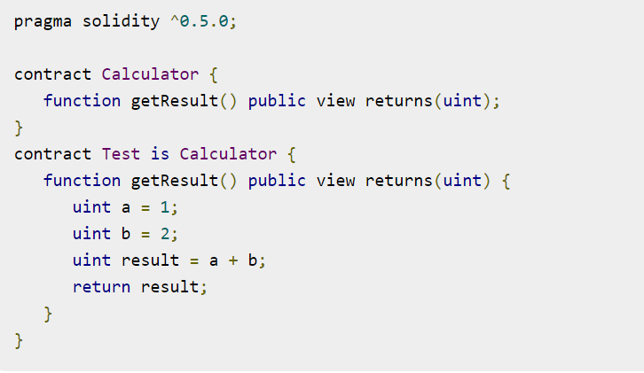
Abstract Contracts
Abstract Contract is one which contains at least one function without any implementation. Such a contract is used as a base contract. Generally, an abstract contract contains both implemented as well as abstract functions. Derived contract will implement the abstract function and use the existing functions as and when required.
In case, a derived contract is not implementing the abstract function then this derived contract will be marked as abstract.

Slide 57
Inheritance
Inheritance is a way to extend functionality of a contract. Solidity supports both single as well as multiple inheritance. Following are the key highlights.
A derived contract can access all non-private members including internal methods and state variables. But using this is not allowed.
Function overriding is allowed provided function signature remains same. In case of difference of output parameters, compilation will fail.
We can call a super contract's function using super keyword or using super contract name.
In case of multiple inheritance, function call using super gives preference to most derived contract.
Use the keyword is to inherit from a contract or an interface.

Slide 58
Inheritance
1. import "./Base3.sol"; // importing the parent contracts / interfaces
2. contract MyContract is Base1, Base2, Base3 {
3. // ... could override the functions of bases and use also by calling them and if a base constructor has parameters we must pass it from the child constructor by calling
parentName(parametersPass) next to child constructor initialization, base could be also
an interface (to be Implemented).
4.}

Slide 59
Inheritance
Start by defining a base contract with a function that is marked as virtual. This means that the function can be overridden in derived contracts. 1. pragma solidity ^0.8.0;
2. contract BaseContract {
3. function myFunction() public virtual pure returns (string memory) {
4. return "BaseContract";
5. }
6. }
1. contract DerivedContract is BaseContract {
2. function myFunction() public pure override returns (string memory) {
3. return "DerivedContract";
4. }
5. }

Slide 60
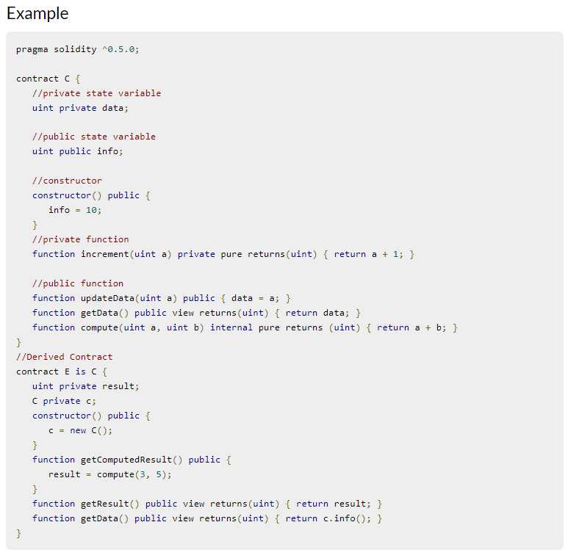
Inheritance

Slide 61
Libraries
Libraries are similar to Contracts but are mainly intended for reuse. A Library contains functions which other contracts can call. Solidity have certain restrictions on use of a Library. Following are the key characteristics of a Solidity Library.
Library functions can be called directly if they do not modify the state. That means pure or view functions only can be called from outside the library.
Library can not be destroyed as it is assumed to be stateless.
A Library cannot have state variables.
A Library cannot inherit any element.
A Library cannot be inherited.
library Search {
function indexOf(uint[] storage self, uint value) public view returns (uint) {
for (uint i = 0; i < self.length; i++) if (self[i] == value) return i;
return uint(-1);
}
}

Slide 62
Libraries Usage
contract Test {
uint[] data;
constructor() public {
data.push(1);
data.push(2);
data.push(3);
data.push(4);
}
function isValuePresent() external view returns(uint){
uint value = 4;
//search if value is present in the array using Library function
uint index = Search.indexOf(data, value);
return index;
}
}

Slide 63
Libraries Usage
Could use keywork using for ; to attach the library for a data type. You may need to import the library if it is written in another file.
Contract Test {
using Search for uint[];
uint[] data;
constructor() public {
data.push(3);
data.push(4);
}
function isValuePresent() external view returns(uint){
uint value = 3;
//Now data is representing the Library
uint index = data.indexOf(value);
return index;
}
}

Slide 64
New Keyword
the new keyword is used to create a new instance of a contract, effectively deploying a new contract on the Ethereum blockchain. It is primarily used for creating contract instances from contract templates or to interact with existing contracts. Here's how the new keyword is used:
You can use the new keyword to create new instances of a contract. This is often used to deploy a new contract on the blockchain.
Example: 1. pragma solidity ^0.8.0;
2. contract MyContract {
3. // Contract state and functions
4. }
To create a new instance of the MyContract contract, you can use the new keyword as follows:
1. MyContract myContractInstance = new MyContract(); // This deploys a new instance of MyContract, and you can interact with it just like any other Solidity contract.

Slide 65
ways to transfer Ether
transfer Function: The transfer function is a method available on all address types
in Solidity. It's a simple and safe way to send Ether and is often used for basic
fund transfers. The transfer function is available on address payable types, and it sends the specified amount of Ether to the recipient. It's a simple way to avoid reentrancy issues.
Example: 1. address payable recipient = 0x1234567890123456789012345678901234567890;
2. function transferEther() public {
3. recipient.transfer(msg.value);
4. }

Slide 66
ways to transfer Ether
send Function: Similar to transfer, the send function is also used to send Ether, but it returns a boolean value indicating whether the transfer was successful or not.
While send returns a boolean, it's important to note that relying solely on the return value for control flow can be dangerous due to the gas stipend and reentrancy issues. Therefore, it's often recommended to use transfer or the more advanced call function.
Example: 1. address payable recipient = 0x1234567890123456789012345678901234567890;
2. function sendEther() public {
3. bool success = recipient.send(msg.value);
4.
5. if (!success) {
6. // Handle failure
7. }
8. }

Slide 67
ways to transfer Ether
call Function: The call function is a more versatile way to send Ether and interact with other contracts. It returns a boolean value, and it can be used to call functions on other contracts, including handling the return values.
The call function allows you to specify the amount of Ether to send along with additional data (function signature and parameters) if you are calling another contract.
Example: 1. address payable recipient = 0x1234567890123456789012345678901234567890;
2.
3. function callTransfer() public {
4. (bool success, ) = recipient.call{value: msg.value}(""); // you could store any of
5. the returned parameter from the function that returns more than 1 value.
6. if (!success) {
7. // Handle failure
8. }
9. }
Notes:
Always be cautious when dealing with Ether transfers in Solidity to avoid security vulnerabilities, such as reentrancy attacks. Also, consider using more advanced patterns, such as the Withdrawal Pattern or checks-effects-interactions pattern, for more complex contract interactions involving Ether transfers.

Slide 68
Terminating a Smart Contract
The smart contract become live once it deployed and if no errors it will counite execute and if we want to terminate it and stop it (like Kill Task) so we could use the keyword selfdestruct.
Here’s an example of how self destruct can be used to destroy a contract and send its remaining ether to a designated recipient:
contract SelfDestructExample {
address payable owner;
constructor() {
owner = payable(msg.sender);
}
receive() external payable {} // added for the contract to directly receive funds
function close() public {
require(msg.sender == owner, "Only the contract owner can call this function");
selfdestruct(owner);
}
}

